Slide 1
Program Slicing
Name : Md Mehedi Hasan
Roll : BSSE 1037
Supervisor :
Abdus Sattar, Lecturer, IIT,
University Of Dhaka

Slide 2
What is Program Slicing ?
Finding all statements in a program that are directly or indirectly affected by a certain variable.
A methodology for omitting program modules that are
irrelevant to a particular computation process based on a criterion known as the slicing criterion.

Slide 3
Motivation
Debugging
Cohesion Measurement
Comprehension
Maintenance and Re-engineering

Slide 4
Some Basic Concepts
Slicing Criterion :
The pair <s,v> is known as Slicing Criterion where ‘s’ is a program point of interest and ‘v’ is a variable we will use for slicing the program.

Slide 5
Some Basic Concepts
Types of program slicing :
Depending on the run-time environment, it can be :
Static slicing
Dynamic slicing
Depending on traversal, it can be
Backward slicing
Forward slicing

Slide 6
Objective of my work
I am using static forward slicing method in this purpose.
Input :
A source code of C / C++ program.
Slicing criterion <s,v>

Slide 7
Objective of my work
Process :
Reading the input file,
Finding variables & then statements dependent on slicing criterion,
Writing these statements into another file.
OutPut :
A sliced compilable source code ( C/C++ ) of the input file.

Slide 8
What I have done so far…
Background study :
Basic concepts & methods of slicing program (Static , dynamic , forward , backward)
Code :
Github link : https://github.com/Mehedi-909/SPL-1

Slide 9
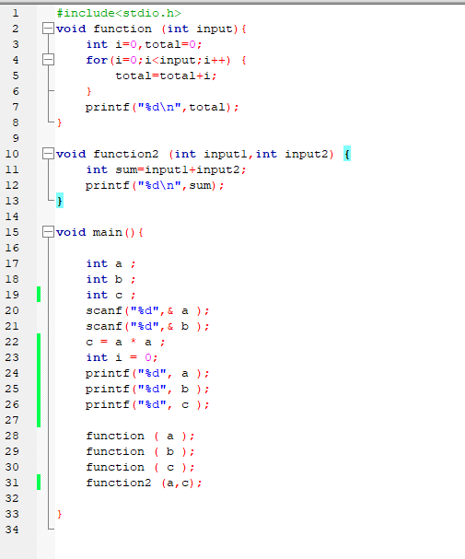
A simple input file & it’s slice slicing criterion <17,a>

Slide 10
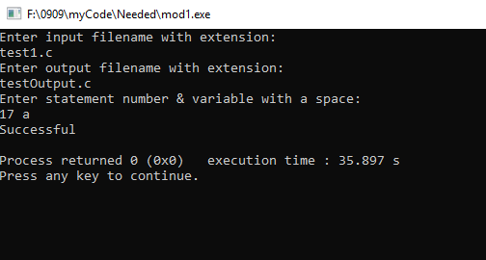
Taking input

Slide 11
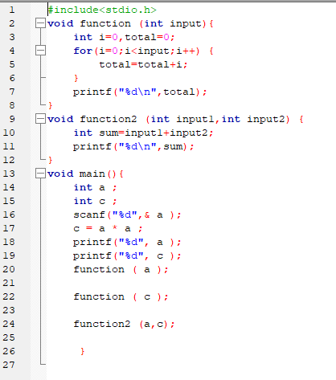
Sliced Output Program

Slide 12
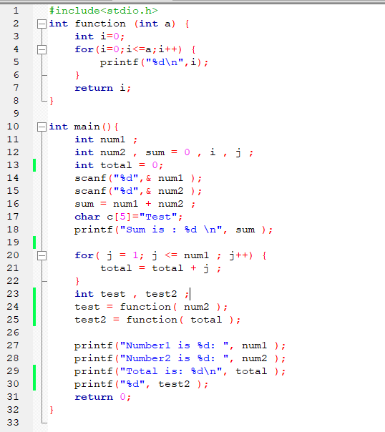
Another example Slicing criterion <11,num1>

Slide 13
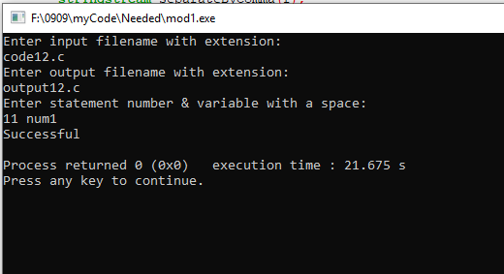
Taking Input

Slide 14
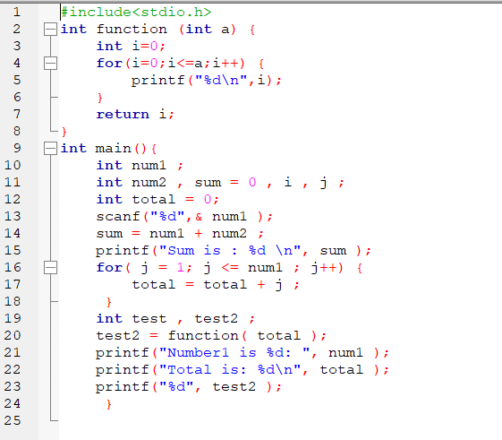
Sliced Output Program

Slide 15
Challenges
Understanding & implementing the algorithm for the very first time.
Parsing each statement and then comparing the data to find dependencies in many ways.
Storing & handling a large size of data.
Finally, making the sliced program executable.

Slide 16
Constraints
Since finding all cases of dependencies is a complex task, this code may not work 100% accurately in all cases depending on code size , complexity and an unusual programming style.

Slide 17
References
https://en.wikipedia.org/wiki/Program_slicing
http://www0.cs.ucl.ac.uk/staff/M.Harman/exe1.html
https://people.eecs.ku.edu/~hossein/Teaching/Fa14/814/.../program-slicing-purvi.ppt
https://www.researchgate.net/publication/2390528_An_Overview_of_Program_Slicing
www.cs.loyola.edu/~binkley/papers/fosm08-slicing.pdf
A survey of program slicing techniques, Frank Tip, IBM T.J. Watson Research Center, PO Box 704, Yorktown Heights, NY 10598, USA

Slide 18
Thank you for your kind observation
& co-operation.

